Slide 1

Computer Engineering Department A.P. Shah Institute of Technology G.B.Road,Kasarvadavli, Thane(W), Mumbai-400615 UNIVERSITY OF MUMBAI Academic Year 2020-2021

Slide 2
Synopsis on Image Captioning Submitted in partial fulfillment of the degree of Bachelor of Engineering(Sem-7) in Computer Engineering By Shyamkrishna Menon – 18102014
Siddharth Nair – 18102044
Atharva Ranade - 18102016
Omkar Thavai – 18102061
Under the Guidance of Prof. S.S. Mujawar

Slide 3
1.Project Conception and Initiation

Slide 4
1.1 Abstract
This project aims at generating automated captions by learning the contents of the image. At present images are annotated with human intervention and it becomes nearly impossible task for huge commercial databases. The image database is given as input to a deep neural network (Convolutional Neural Network (CNN)) encoder for generating “thought vector” which extracts the features and nuances out of our image and RNN (Recurrent Neural Network) decoder is used to translate the features and objects given by our image to obtain sequential, meaningful description of the image. In this project, we systematically analyze different deep neural network-based image caption generation approaches and pretrained models to conclude on the most efficient model with fine-tuning.

Slide 5
1.2 Objectives
The goal of image captioning is to automatically generate descriptions for a given image, i.e., to capture the relationship between the objects present in the image, generate natural language expressions , and judge the quality of the generated descriptions.
To implement a transfer learning approach to generate automated captions for any given image. In this model the encoder used is pre-trained VGG16 model

Slide 6
1.3 Literature Review
Deep Learning based Automatic Image Caption Generation
The aim of the paper is to generate captions to the image which is normally, manually annotated by data annotators. It first creates feature vectors with the help of CNN and later uses RNN for creation of sentences with the help of features gained before.
For the purpose of automated captioning, a pre-trained model called VGG16 model is being used. This model makes use of a recurrent neural network which encodes the variable length input into a fixed dimensional vector and uses this representation to “decode” it to the desired output sentence. An encoder is a process of extracting vectors which describe contents of an image. A decoder reverses the process of encoding. Decoder process uses layers like tokenizer, embedding, GRU and dense layer.
This paper uses 2 approaches for obtaining image captioning with the same dataset i.e. MS-COCO, one without using Attention Model and one using Attention Model. Finally, the paper concludes with important points like different epochs used for different models, deeper network constitutes to easier image captioning, etc.

Slide 7
1.3 Literature Review (contd..)
Image Annotation via deep neural network
This paper proposes a novel framework of multimodal deep learning where the convolutional neural networks (CNN) with unlabeled data is utilized to pre-train the multimodal deep neural network to learn intermediate representations and provide a good initialization for the network then use backpropagation to optimize the distance metric functions on individual modality.
Automatic image annotation using DL representation
In this paper, the last layer of CaffeNet of the CNN based model is replaced with a projection layer to perform regression and the resulting network is trained for mapping images to semantically meaningful word embedding vectors. Advantage of this modelling is: firstly, it does not require dozens of handcrafted features and secondly, the approach is simpler to formulate than any other generative or discriminative models.

Slide 8
1.3 Literature Review (contd..)
Show and Tell: A Neural Image Caption Generator
This paper proposes a network of the same name. In this network, deep convolutional network is used for image classification and sentence generation is done by a powerful Recurrent Neural Network which is trained with the visual input so that RNN can keep track of the objects explained by the text.

Slide 9
1.4 Problem Definition
The problem introduces a captioning task, which requires a computer vision system to both localize and describe salient regions in images in natural language. The image captioning task generalizes object detection when the descriptions consist of a single word. Given a set of images and prior knowledge about the content find the correct semantic label for the entire images. First, it is necessary to detect objects on the scene and determine the relationships between them and then, express the image content correctly with properly formed sentences. The generated description is still much different from the way people describe images because people rely on common sense and experience, point out important details and ignore objects and relationships that they imply .

Slide 10
1.5 Scope
The main implication of image captioning is automating the job of some person who interprets the image (in many different fields). Probably, will be useful in cases/fields where text is most used and with the use of this, you can infer/generate text from images.
Social media platforms like Facebook can infer directly from the image, where you are ( beach, cafe etc), what you wear (colour) and more importantly what you’re doing also (in a way).
It will also be helpful to improve search results of google image search.

Slide 11
1.6 Technology stack
Keras – For Deep Learning Tasks
Tenserflow – For Deep learning Tasks
Pandas – To load the dataset and perform various tasks
Numpy – To do mathematical functions
Flask – For Hosting on Web
OpenCV – For Handling Images
Matplotlib and Seaborn – For plotting and visualization purposes

Slide 12
1.7 Benefits for environment & Society
Image Captioning can play a big role for society.
Our project can be used for educational purpose for teaching pre-primary children to make them aware with what all entities are present within a picture.
Our image captioning model can be used for enhancement of products like Google Lens. Google Lens is used by users to identify objects and provide relative e-commerce links. With our project imbibed, Lens can also explain the scenario to a confused user.

Slide 13
2. Project Design

Slide 14
2.1 Proposed System
First we will import Flickr 30k dataset and process. Flicker datasets are used for image captioning. 30k stands for 30,000 images of various instances.
We use VGG16 model for image captioning. VGG16 is used for embedding of features within the image like identifying a person, thing, etc and LSTM is used for encapsulating all features and describing it as a sentence.

Slide 15
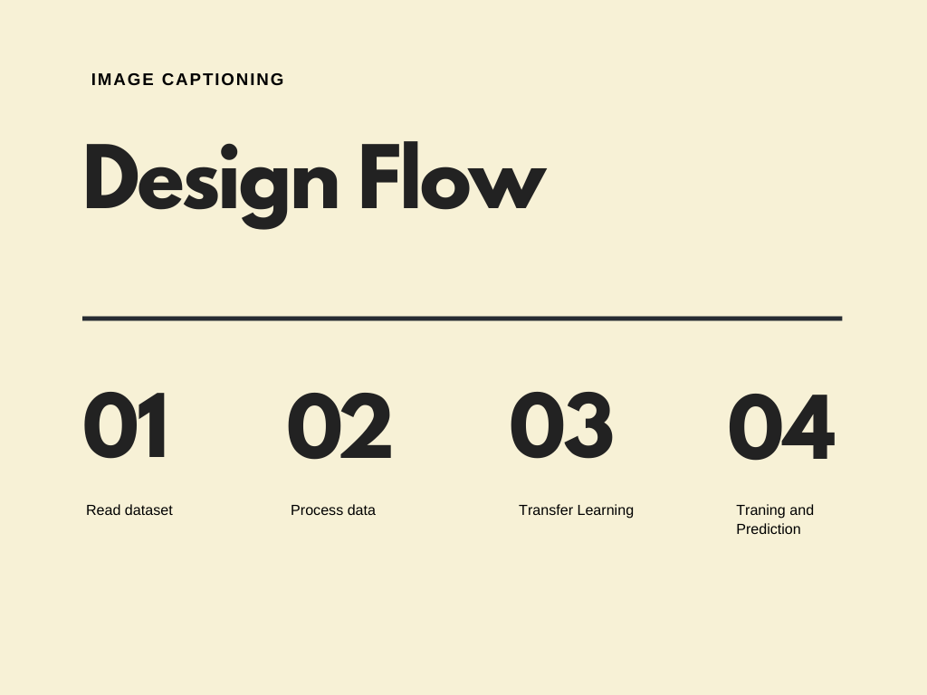
2.2 Design Flow

Slide 16
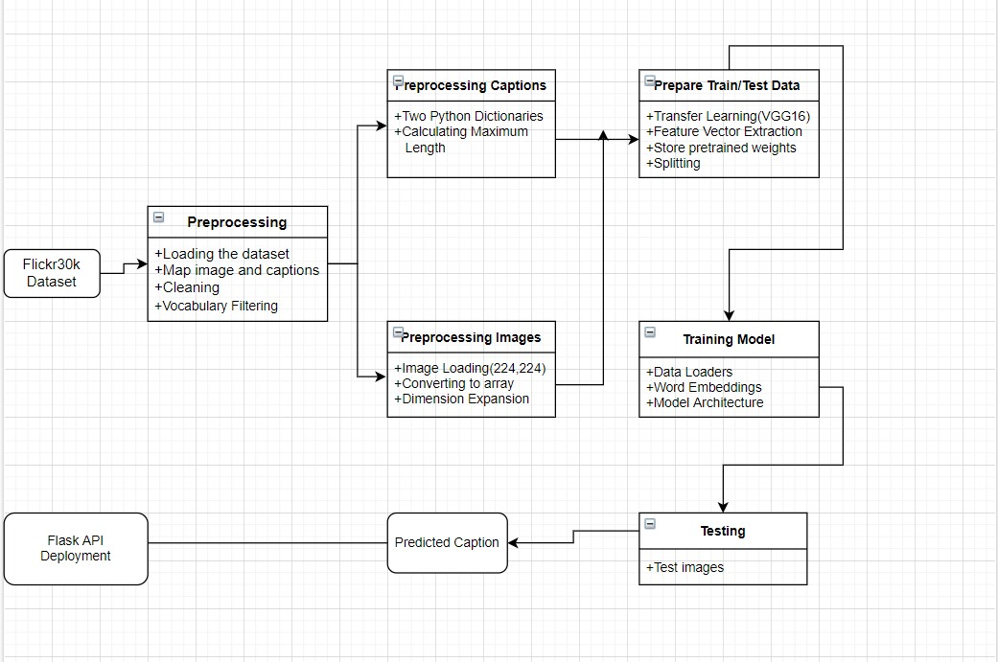
2.3 Class Diagram

Slide 17
2.4 Modules
Read Dataset
Processing of data
Transfer Learning
Training and Prediction

Slide 18
Module 1- Read Dataset
We read the Flickr 30k dataset

Slide 19
Module 2- Processing of data
There are few sub-steps for implementing processing of the dataset
We first input the .csv file. This file will have ImageID of the image and associated captions. An image can have multiple captions.
A description (dictionary) is created where ImageID is considered as key and caption is value.

Slide 20
Since caption can have few unwanted characters eg. #, etc, we remove them. All the cleaned captions are inputted into a text file. We create a vocabulary i.e. count of each word in a caption and count of each word in the whole text document.

Slide 21
A threshold is set so as to keep relevant words only, relevance is found if word count is greater than or equal to threshold.
We create a train and test dataset
Now a start and end sequence has been created.

Slide 22
Module 3- Transfer Learning
We use VGG16 for feature capture. VGG16 is a convolution neural net (CNN) architecture. It is considered to be one of the excellent vision model architecture till date. There are 16 layers in VGG16 model.

Slide 23
Module 4- Training and prediction
We first load our data into batches for word embedding process. Word embedding will help us find feature vectors for the words in the training set.
Then a model architecture is been formed. We will use LSTM for sentence formation from the features of caption.
Lastly we predict test sets captions.

Slide 24
2.5 References
V.Keshavan et al., “Deep Learning based Automatic Image Caption Generation”
O.Vinyals et al., “Show and Tell: A Neural Image Caption Generator”
S.Chengjian et al., “Image Annotation Via Deep Neural Network”
V.Murthy et al ., “Automatic Image Annotation using Deep learning representations”

Slide 25
3.Planning for next semester

Slide 26
Planning
We will incorporate our model into web. In this manner, anyone can upload an image and a suitable caption will be provided to it.
We will find perfect set of parameters during model architecture.

Slide 27
Thank You

